Slide 1
Customer Retention Project
SANDES P

Slide 2
DATA
We are provided with customer survey data about e-commerce websites in India
The data is in Excel format and it contains two sheets
Data contains 269 rows and 71 columns

Slide 3
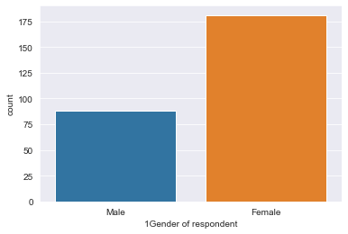
PLOTS
Male respondents are lesser than female respondents

Slide 4
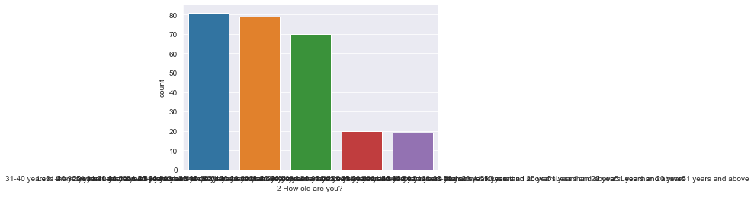
Most of the respondents belongs to the age group 30-40

Slide 5
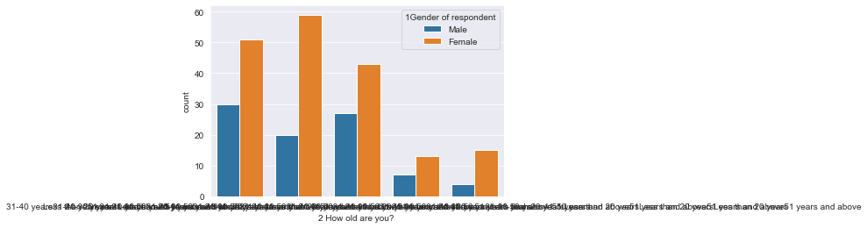
In all age slabs, female respondents are higher

Slide 6
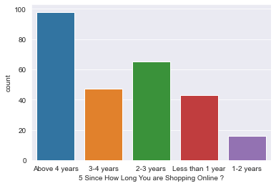
The largest number of respondents have more experienced

Slide 7
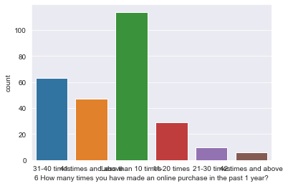

Slide 8
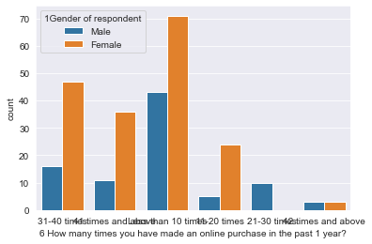

Slide 9
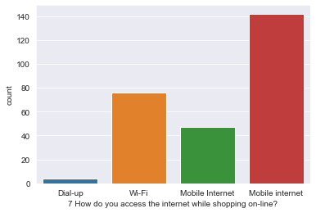
Female users purchase more than men

Slide 10
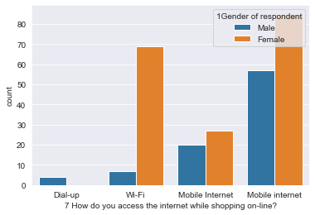
Most of the users mobile internet to purchase online

Slide 11
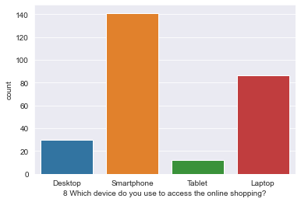
since most of the users use mobile internet to purchase, smartphone will be their device

Slide 12
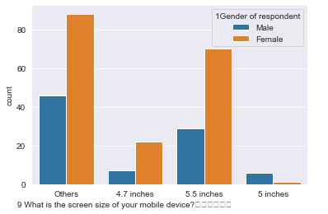

Slide 13
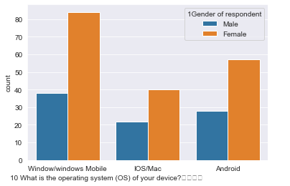
More people using windows OS for purchasing online

Slide 14
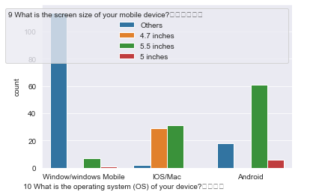

Slide 15
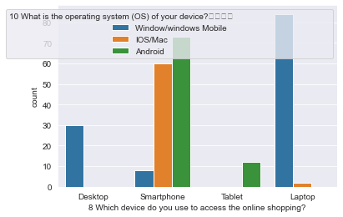
There are no repondents from Mac(Desktop) users
Most of the respondents from smartphones are Android users
Laptop users are more than desktop users
Respondents who use apple laptops are very less

Slide 16
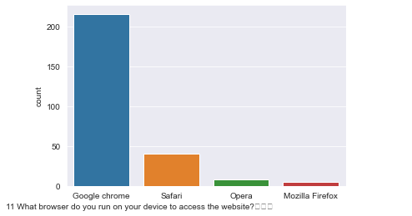

Slide 17
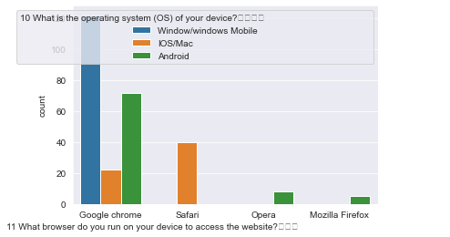
In Google Chrome users, most of them are using windows OS
There are very few are using Mozilla Firefox and Opera browser
Around half of the IOS users use chrome for online shopping

Slide 18
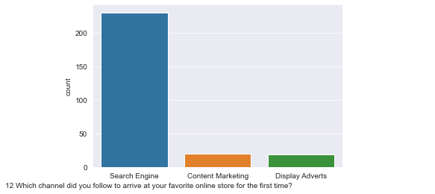
Most of the users reached the shopping website by the search engine for the first time
Only less than 20% of the customers visit the shopping website through content marketing and advertisements

Slide 19
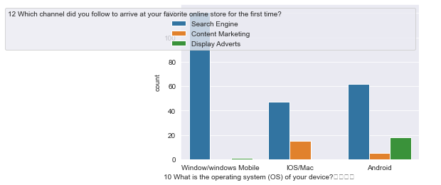
No customers reached through content marketing from windows OS
NO customers reached through adverts from IOS

Slide 20
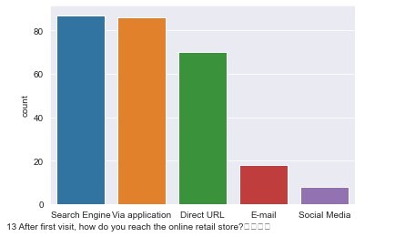
After the first use people who use application direcly increses
After the first use, people browse url directly also increases

Slide 21
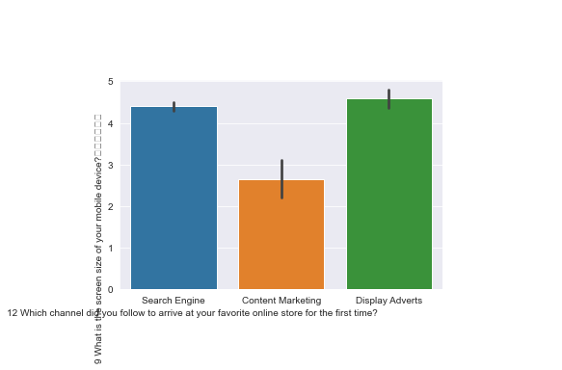
Customers which earned through content marketing was through lesser screen size devices

Slide 22
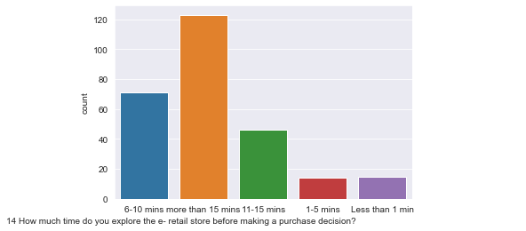
Most of the people spend more than 15 minutes to make a decision to purchase

Slide 23
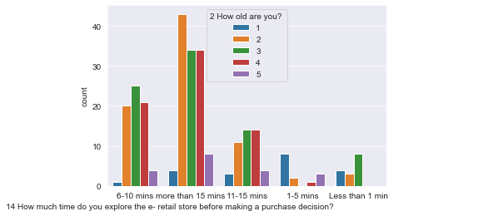
People who have age between 20 and 30 take more time to make purchase decision
People between 30 and 40 make purchase decision very quickly

Slide 24
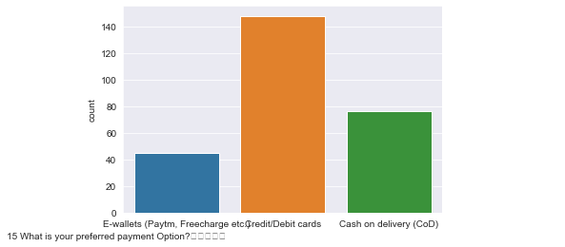
Most of the people use card transactions for purchase

Slide 25
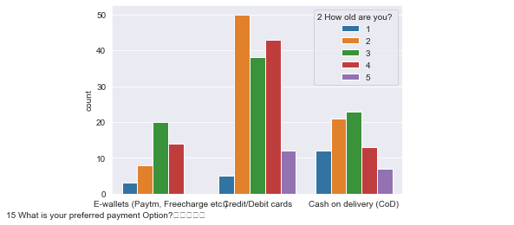

Slide 26
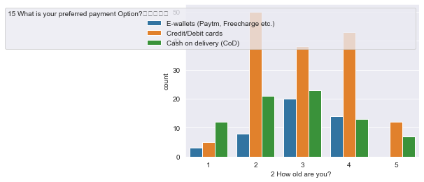
People who aged between 20 and 30 mainly uses card(credit/debit) for purchase
People aged above 50 not at all using e wallets for purchasing

Slide 27
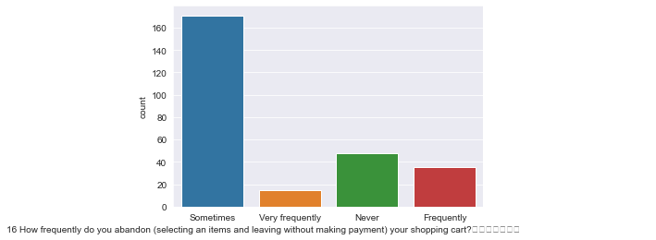

Slide 28
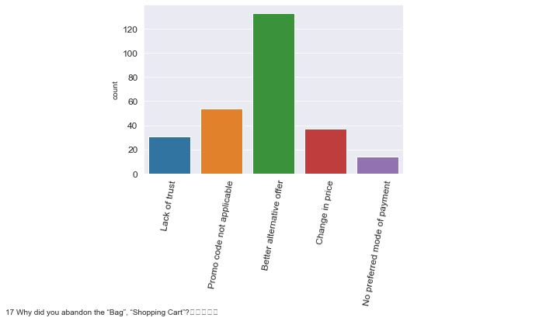
Most of the people abandon cart because of the better alternative offer

Slide 29
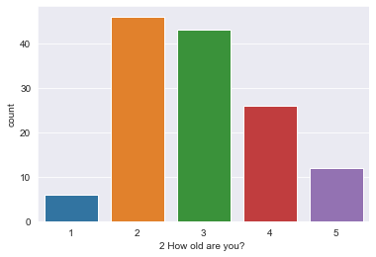
People ages between 20 and forty are looking for alternative offers aggressively

Slide 30
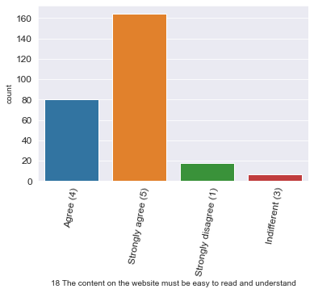
Most of the users agree that their online store website is easily readable

Slide 31
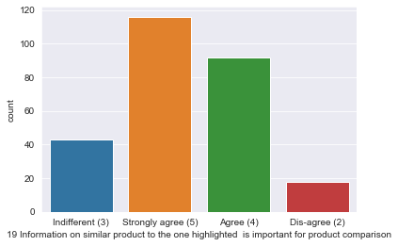
most of the people agree that product comparison is good on their online shopping website

Slide 32
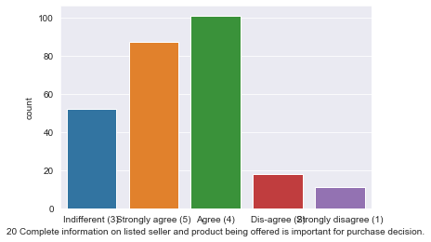

Slide 33
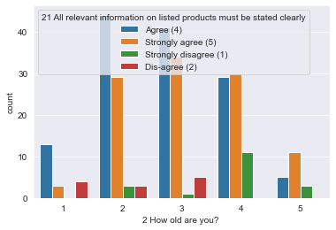
People aged between 20 and 40 are satisfied with the relevent information about the product on the shopping website

Slide 34
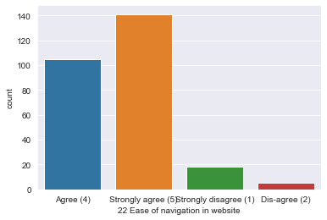
Most of the websites have easy navigation system

Slide 35
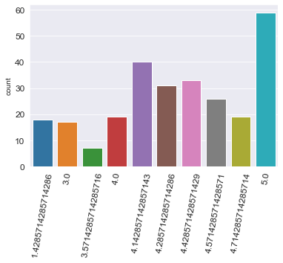
Respondents rated as overall good as website performance like design, loading, info etc

Slide 36
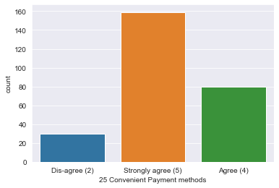

Slide 37
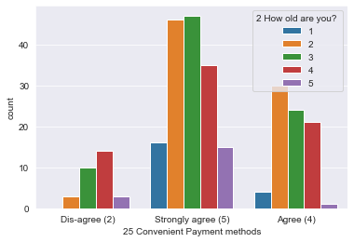
Most of the customers are satisfied with the payment options given on the shopping website

Slide 38
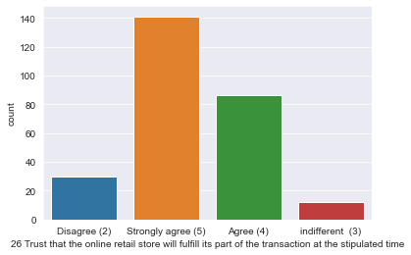

Slide 39
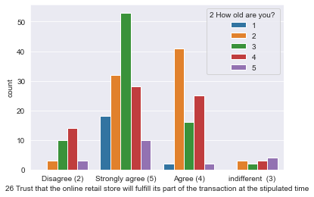
Most of the peple trust the transaction system
People in 30s trust the transaction fullfilment most people in 40s have less trust

Slide 40
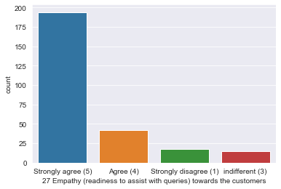
Majority of people agree that shopping website has empathy

Slide 41
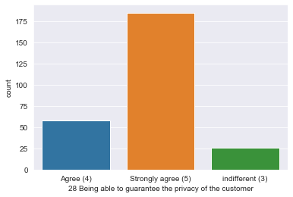

Slide 42
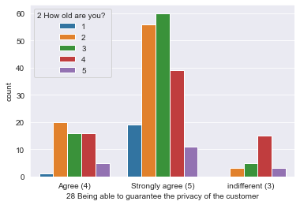
Most of the users are thinking the website gives good privacy to them

Slide 43
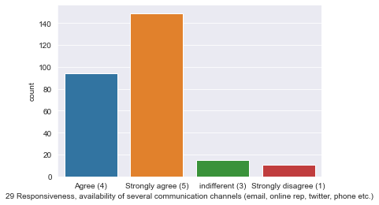
above 50% people agree that their shopping website has good communication

Slide 44
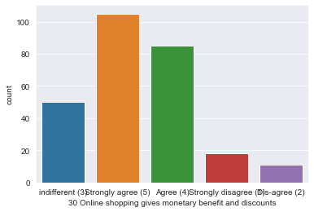
MOst of the people think that they are saving when they shop online
Very few people think that there is no benefit in purchasing online

Slide 45
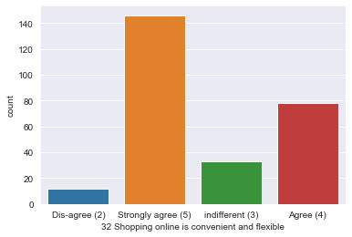
Online shopping is convenient for most of the people

Slide 46
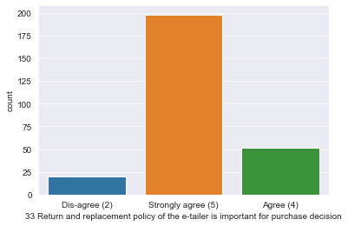
It is obvious that return policy is matter for most of the people

Slide 47
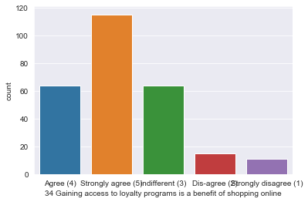

Slide 48
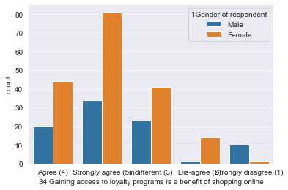
Female users consider loyality point is important than males

Slide 49
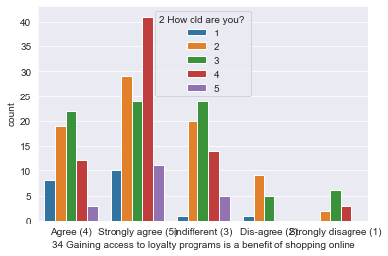

Slide 50
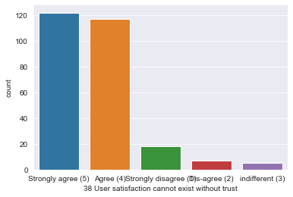
Trust and satisfaction are correlated

Slide 51
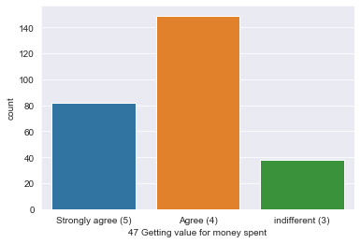

Slide 52
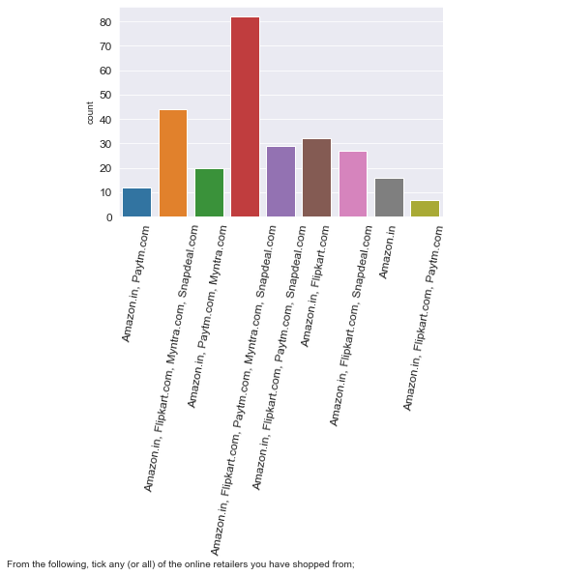
All people used Amazon.in for online purchase
Most of the people used Flipkart for online purchase

Slide 53
Myntra has lesser number of customers as per the response
Flipkart and Amazon are the most easy usable platforms
Paytm is the lease easy usable
Amazon is the most visually appealing website
Snapdeal is the least visually appealing website

Slide 54
Amazon and Flipkart are leading in variety of products
Snapdeal and Paytm have less variety products
Amazon gives high in description
Lowest for snapdeal and Paytm
Amazon has the highest loading speed
Myntra has least loading speed

Slide 55
amazon has highest reliability
Snapdeal has least reliability
Customers who use Amazon have opinion that they can purchase quickly from the website
For different payment options, Amazon and Flipkart are almost same
Paytm has least no. of payment method

Slide 56
Amazon has the greatest delivery speed
No respondents choose Paytm
Amazon offers good privacy to the customers
Aound half of the respondents who are purchasing from Flipkart do not think they give privacy

Slide 57
CONCLUSION
By using above customer data, we can say that Amazon scores the highest score in terms of website quality and service related to the products
Second best score is for Flipkart
More than 80% of the people recommend amazon to their friends or family

